Slide 1
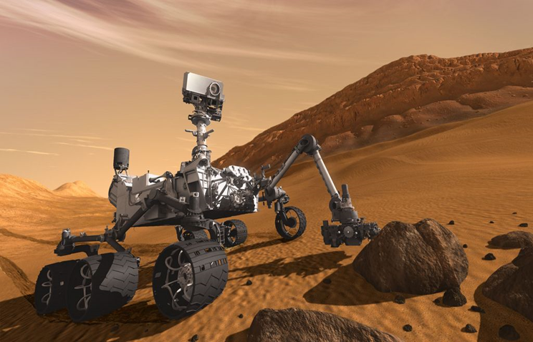
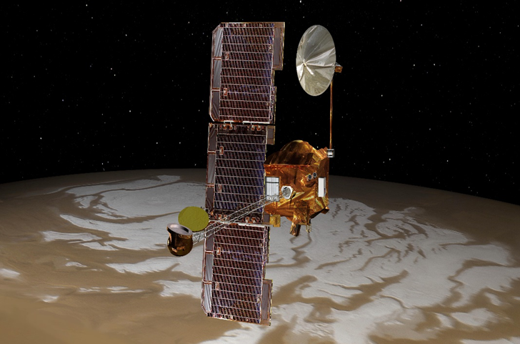
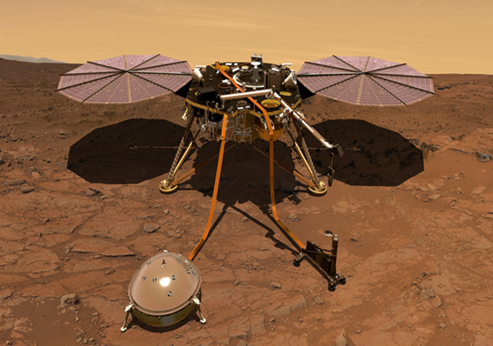
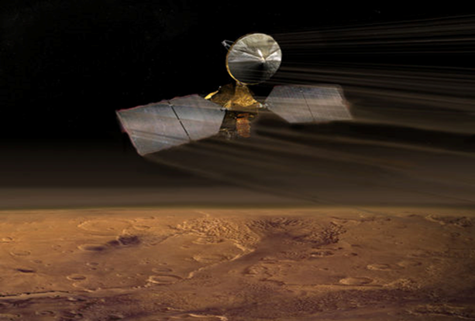
SPECIFIC EQUIPMENT USED IN ROVERS, ORBITERS and LANDERS TO FIND LIFE
Curiosity Rover Odyssey Orbiter Insight Lander Reconnaissance Orbiter

Slide 2
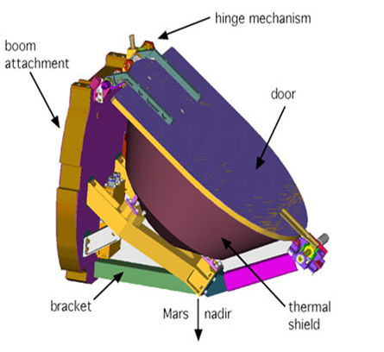
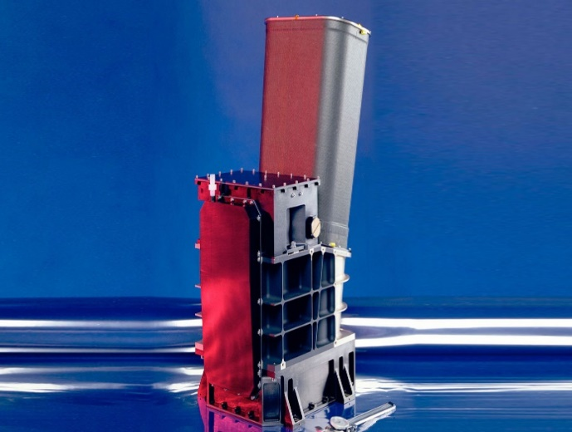
Finding Evidence of Water on Mars
If Finding Life that Now Exists If Finding Life that Existed
Gamma Ray Spectrometer Thermal Emission Imaging System
From space it can detect the presence of water or ice in the soils up to 1 meter below the surface.
This equipment has the ability to map the surface for the distribution of minerals that are only able to form in the presence of water.

Slide 3
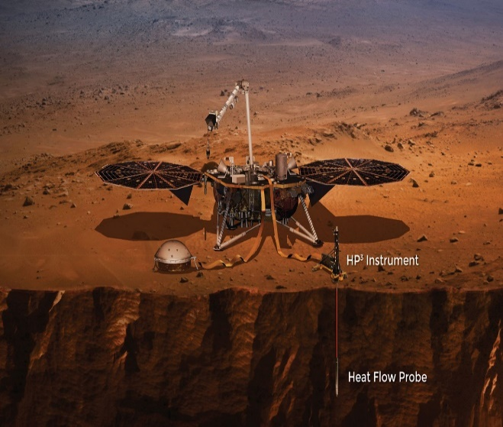
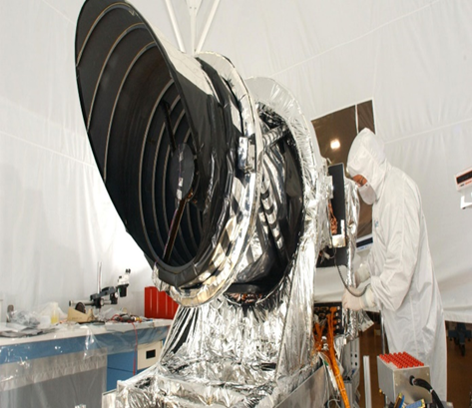
Energy Sources for Possible Life on Mars
If Finding Life that Now Exists If Finding Life that Existed
Heat Flow Probe High Resolution Imaging
Measures the temperature deeper underneath to surface to help identify where sources of geothermal energy may be located.
Takes images of small objects in terrain such as gullies and layered deposits from space & can identify the kinds of minerals that may provide chemical energy.

Slide 4
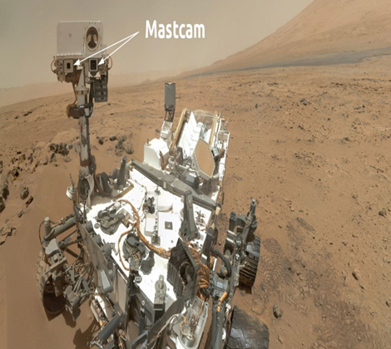
Using Rover Camera to find a General Location
Rover Mastcam
If Finding Life that Now Exists If Finding Life that Existed
The camera specifically looks for the best locations on the surface to find water underneath the ground based on the area that the Gamma Ray Spectrometer found from space above.
The camera specifically looks for land formations such as gullies or layered rock deposits that indicate water may have flowed in the area in the past.

Slide 5
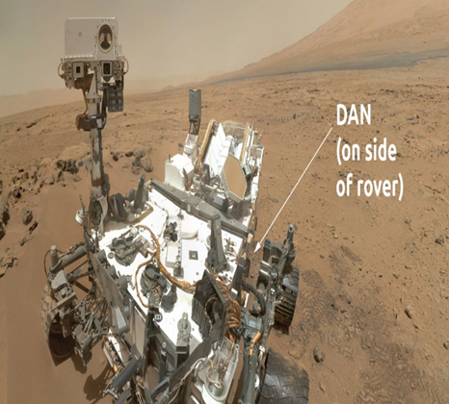
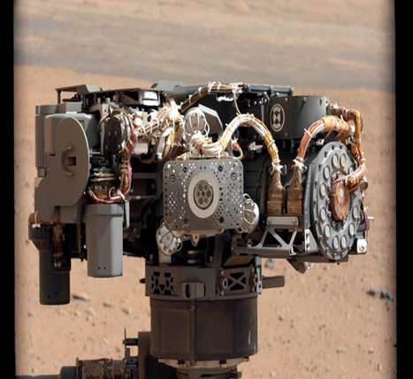
Finding Water Beneath the Surface Finding Carbonate or Oxide Minerals in the Soil
If Finding Life that Now Exists If Finding Life that Existed
Dynamic Albedo of Neutrons Alpha Particle X-Ray Spectrometer
Detects if the minerals and soil beneath the surface contain water in them using radiation, and whether there are layers of ice below.
Detects the chemical elements contained in rocks and minerals such as oxygen that make up oxides and carbonates.

Slide 6
Finding Carbon Compounds to show that life (exists or existed)
Sample Analysis at Mars Instruments
Using three instruments it searches for compounds that contain carbon in them such as methane and amino acids.

